Slide 1
Using the Future to Segment Your Users
Robert Do, Wharton School, W’10

Slide 2
Segmentation Findings
Segmentation based on the future produces distinct high, medium, and low user segments with predictions on each segment’s future activity
It uncovers which 10.3% of users will make up 70.7% of activity in the future
The model can forecast activity in weeks 11 – 69 from the activity in weeks 1 – 10

Slide 3
Segmentation is often based on past data
Segmentation puts users into groups that share similar usage behavior
Examples
“All users who made 0 events last month”
“Users who made only 1 event last month”
“Users who made 5+ events last month”
Grouping on past behavior is troubling for decisions to be made for the future…

Slide 4
What if you drafted baseball players based on their single game batting averages?
The player may have been lucky and his average was higher than his true average, or vice versa
Should we pick our users based on 10 week usage behavior? They may have been similarly lucky!

Slide 5
Customers should be segmented based on what they WILL do in the future
We need to know their true “batting average” or true “average usage per month”
We don’t have the future, but we can predict it

Slide 6
Let’s take a look at our data
The data consists of the activity over 69 weeks for the cohort of users who joined in Jan 2009.
p1x = number of days a user logged on to create an event in weeks 1 – 10 (excluding join day)
tx = week of most recent usage
T = length of weeks user has been observed
p2x = number of days a user logged on to create an event in weeks 11 – 69 (used for holdout and testing)
Sample of the data
ID | p1x | tx | T | p2x
493836 | 0 | 0 | 10 | 0
493856 | 1 | 0.714286 | 10 | 1
493871 | 0 | 0 | 10 | 0
493878 | 0 | 0 | 10 | 0
493880 | 0 | 0 | 10 | 0

Slide 7
K-means clustering is used to form groups of similar users
This algorithm groups users into k number of clusters where everyone is most similar to others within their cluster and most dissimilar to users in other clusters.
Data used when clustering on observable characteristics (traditional method)
p1x = activity in first 10 weeks
T-tx = Time elapsed since last usage
Data used when clustering on unobservable characteristics (future behavior method)
Conditional expectation = expected number of days product will be used in weeks 11 – 69

Slide 8
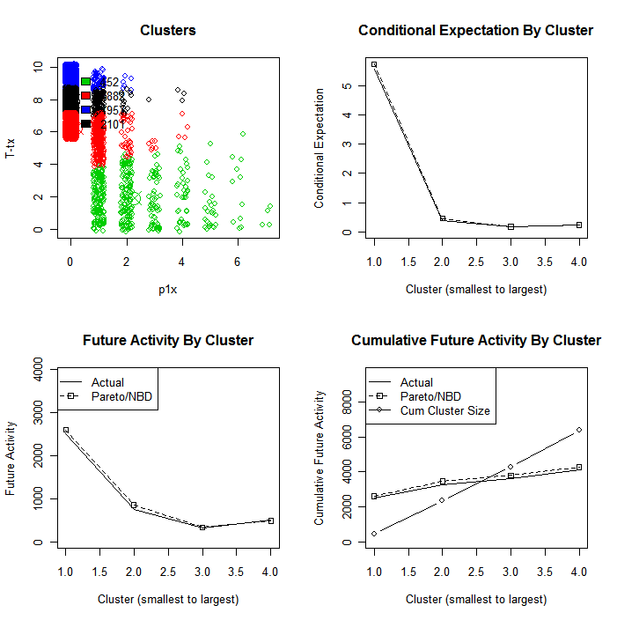
Clustering based on past data
Cluster | 1 (active) | 2 (triers) | 3 (triers) | 4 (triers)
Size | 452 | 1882 | 1962 | 2096
Conditional expectation | 5.75 | 0.45 | 0.23 | 0.17
Total expected usage | 2598 | 855 | 457 | 361
Months between each usage | 2.4 | 30.0 | 58.4 | 79.1
Makes accurate predictions, but produces only 2 segments

Slide 9
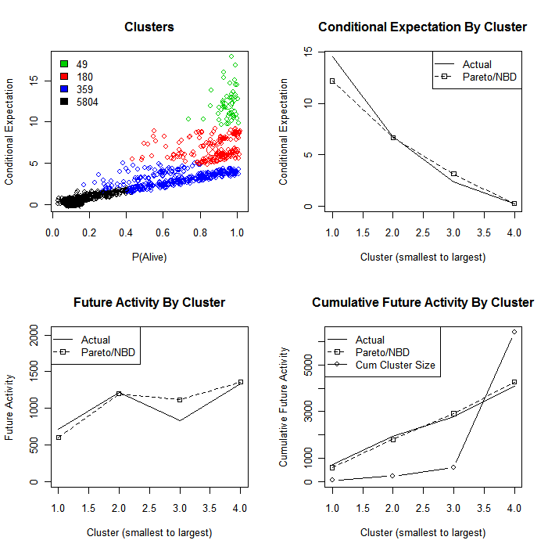
Clustering based on conditional expectation
Cluster | 1 (high) | 2 (med) | 3 (low) | 4 (triers)
Size | 49 | 180 | 359 | 5804
Conditional expectation | 12.19 | 6.66 | 3.11 | 0.23
Total expected usage | 597 | 1198 | 1118 | 1357
Months between each usage | 1.1 | 2.0 | 4.4 | 58.2
Produces much more meaningful segments

Slide 10
A better answer to the 80/20 problem
Which would you rather know…
“Which 20% of my customers made up 80% of my sales?
or
“Which 20% of my customers will make up 80% of my sales?
Traditional approaches based on the past tell you the former, but the latter is more useful for the future.

Slide 11
Eventbrite has a 10/70 problem
If you target only the users who have a conditional expectation of at least 1, this constitutes 10.3% of users who are expected to make up 70.7% of the future activity.
You can now make your targeting decisions based on what will happen in the future rather than on old past data.

Slide 12
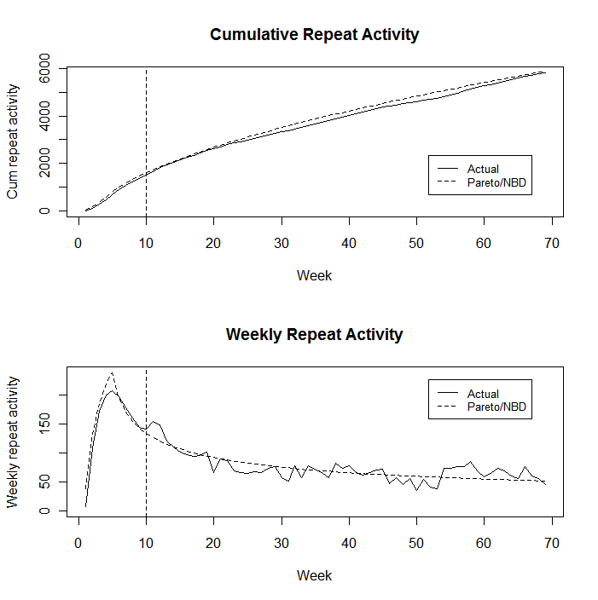
Forecasting activity in weeks 11 – 69
Mean average percentage error in weeks 11 – 69 is 3.76%
Week 69 forecast is off by 1.10%

Slide 13
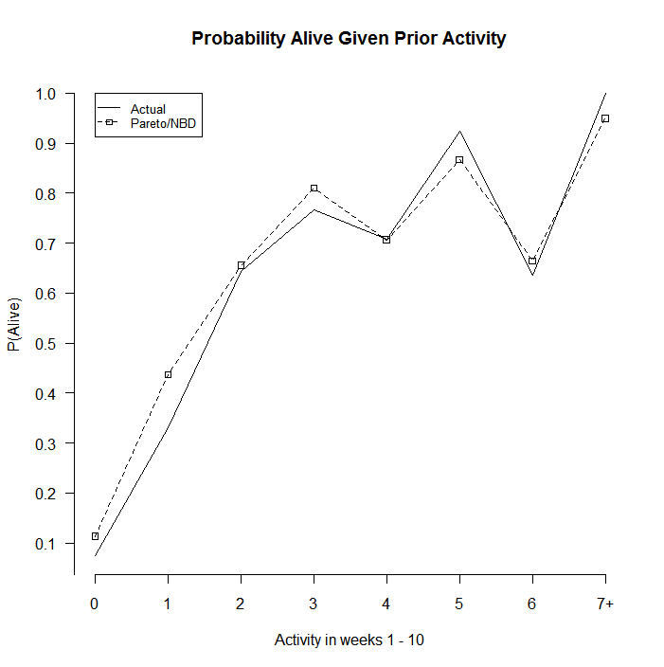
Is a user dead or alive?

Slide 14
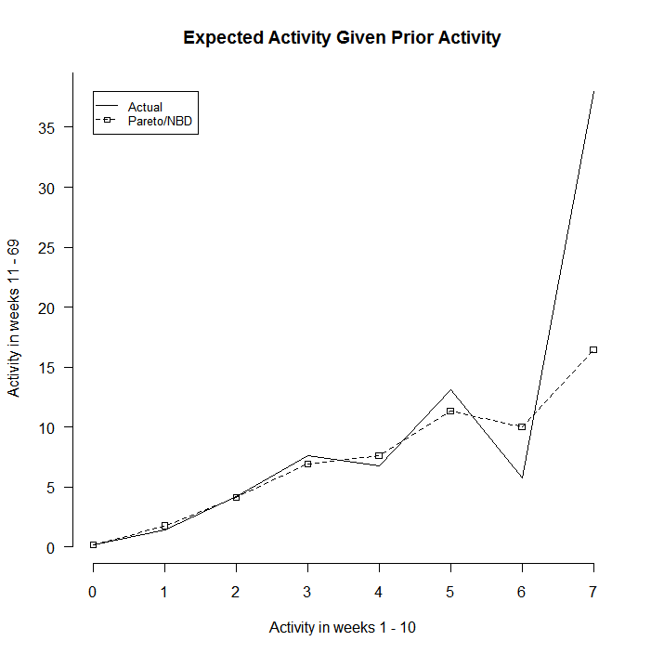
Forecasts of expected future activity

Slide 15
The next step is to identify best actions to take for each cluster
Each user is now assigned to a cluster. Match the information from the user database to the users in order to find commonalities in each cluster. Database information may include
Revenue information
Qualitative information such as event vertical
Percent of features user is utilizing
Commonalities inform us of
Appropriate messaging in reaching out
Appropriate tactics in reaching out
Whether user brings in enough sales to be worth the cost of reaching out

Slide 16
References
Fader, Peter S., Bruce G. S. Hardie, and Ka Lok Lee (2005), “A Note on Implementing the Pareto/NBD Model in Matlab.” <http://brucehardie.com/notes/008/>
Schmittlein, David C. , Donald G. Morrison, and Richard Colombo (1987), “Counting Your Customers: Who They Are and What Will They Do Next?” Management Science, 33 (January), 1 – 24.

